Slide 1
Introduction To Jupyter
BSIDES LONDON 2021
JERRY GAMBLIN
Director Of Security
November 12th 2021

Slide 2
About Me
Jerry Gamblin
Director Of Security Research
@jgamblin
gamblin@cisco.com
www.jerrygamblin.com

Slide 3
Introduction to Jupyter
Walkthrough & Examples
Let’s Build Something

Slide 4
Introduction to Jupyter

Slide 5
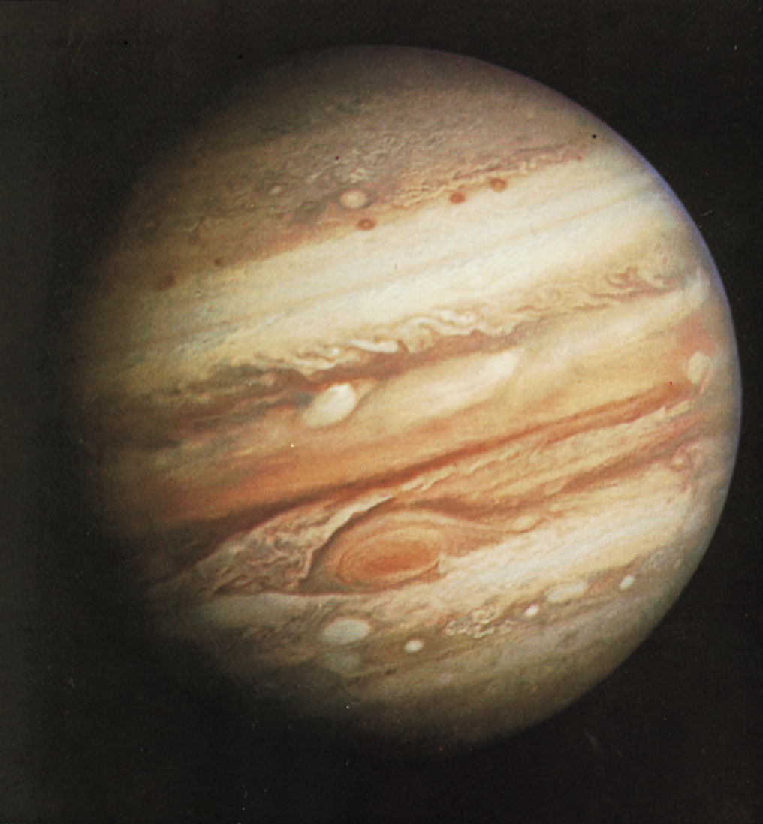
Jupiter Facts
The largest planet.
5th planet from the sun.
Shortest Days
10 Earth Hour
Longest Years
12 Earth Years

Slide 6
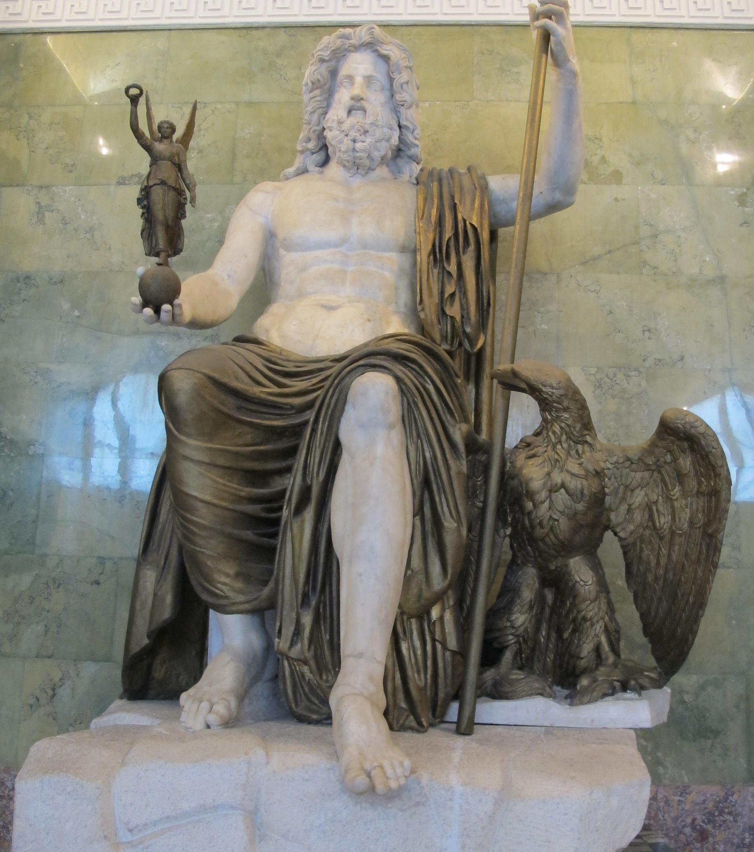
Jupiter Facts
King Of The Gods
Has A Cool Eagle As A Pet
A Zeus Knockoff?

Slide 7

Jupyter Facts
Interactive python shell opened within the browser.
Founded in 2014
“Easy-ish R”

Slide 8
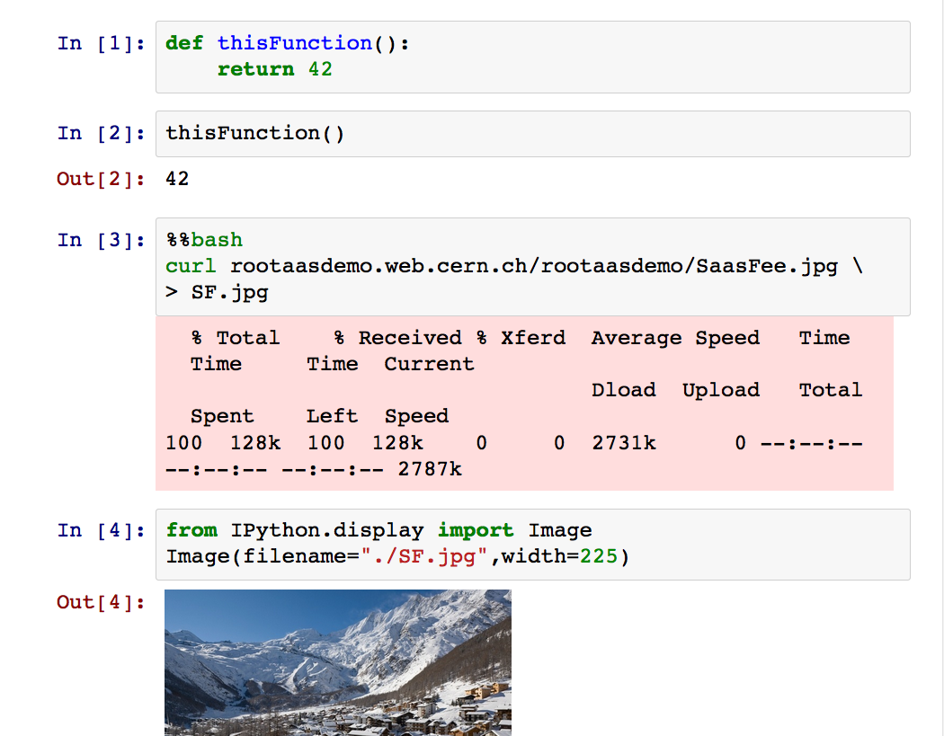
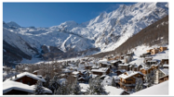
http://
In a browser
Text and Formulas
Code
Shell Commands
http://
Images

Slide 9
Data Analysis as a Service
Platform independent: only with a web browser
Analyze data via the Notebook web interface
No need to install and configure software
Calculations, input and results “in the cloud”
Allow easy sharing of scientific results: plots, data, code
Simplify sharing of POCs
Ease reproducibility of results and documentation

Slide 10
Software Options

Slide 11
Local
In your IDE
VSCode
Local Browsers
brew install jupyterlab
pip install jupyterlab
Stand Alone App
Jupyter Lab Desktop
https://github.com/jupyterlab/jupyterlab-desktop

Slide 12
Remote
Run A Public Server
https://jupyter-notebook.readthedocs.io/en/stable/public_server.html
My Binder
https://mybinder.org/
Colab from Google
https://colab.research.google.com/

Slide 13
Why Colab?
Free-ish
Fast
GPU Support
Want To Crack Passwords?

Slide 14
Software Repo https://github.com/jgamblin/JupyterWorkshop

